Slide 1
Sustainable AI-Driven Cybersecurity: Minimizing Server Downtime Through Intelligent Threat Detection

Slide 2





Faces
Course Instructor
DR. MOHAMMAD MAHMUDUL HASAN
SL_16
MD. SHARUL ISLAM
(22-46327-1)
SL_38
RIFAH SANZIDA
(22-47154-1)
SL_17
HASEBUL HASAN
(22-46328-1)
SL_37
MD. SAMIN YEASAR
(22-47139-1)

Slide 3
Table of Contents
01
02
03
04
Introduction
Methodology
Background, Related studies, Objective, Contribution
Data collection, Procedure
Result & Analysis
Conclusion
Research Results, Analysis-Discussion
Summary of the study, Limitations, Future Works

Slide 4
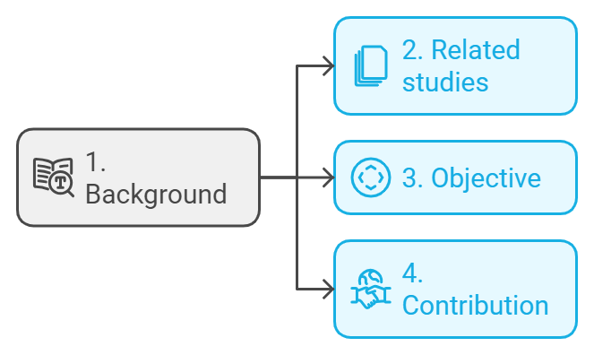
Introduction
Problem Background
Related Studies
Research Objectives
Research Contributions

Slide 5
Problem Background
Cyber crime causes huge money loss annually(CV(2023))
Significant data loss
Server downtime issues

Slide 6
Related Studies
Abdullahi et al. (2022):AI-driven threat detection minimizes server downtime by using models like SVMs, Random Forests, and CNNs to quickly identify and respond to cyber threats, ensuring system availability.
Ansari MF (2022):AI-driven threat detection minimizes downtime by rapidly identifying and mitigating threats in real-time, enabling swift responses and reducing the impact on server operations.
Homaei et al. (2024):AI-driven threat detection reduces downtime with real-time monitoring, automated responses, and predictive analytics using Deep Learning, SVMs, and Random Forests.

Slide 7
Related Studies(cont.)
Research Gap:
To predict and mitigate server disruptions in real time.
Very few studies related to server downtime specifically.

Slide 8
Research Objective
Motivation: Address limitations of traditional cybersecurity, which often reacts too late to prevent server outages.
Objective: Develop and evaluate AI-driven models to predict cyber threats and reduce server downtime.
RQ1: How can AI-driven threat detection minimize server downtime in real-world environments?
RQ2: What machine learning models are most effective in proactively identifying potential server disruptions?

Slide 9
Research Contribution
AI revolutionizes threat detection and response.
Reduces server downtime.
Audience: IT admins, cybersecurity experts, critical infrastructure sectors.
Applicable in finance, healthcare, etc.
Ensures continuous operations and mitigates financial losses.

Slide 10
Methodology
Methodology: Mixed-methods approach using Systematic Literature Review (SLR).
Focus: Analyze how AI-driven cybersecurity minimizes server downtime through intelligent threat detection.
Purpose of SLR:
Gather and analyze existing research on AI-based threat detection and machine learning in cybersecurity.
Identify gaps in current research for further exploration.
Outcome: Provides theoretical and practical insights to address research questions.

Slide 11
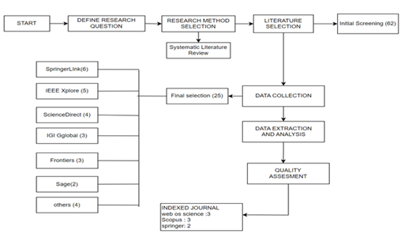
Process of Methodology

Slide 12
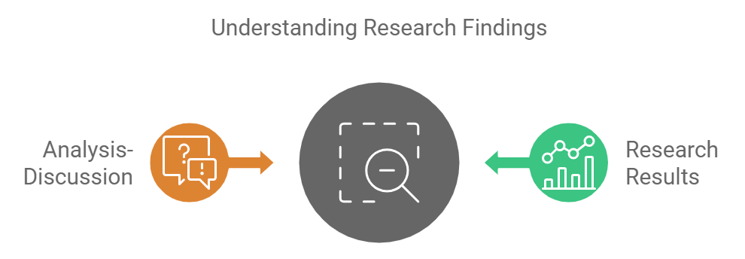
Result & Analysis

Slide 13
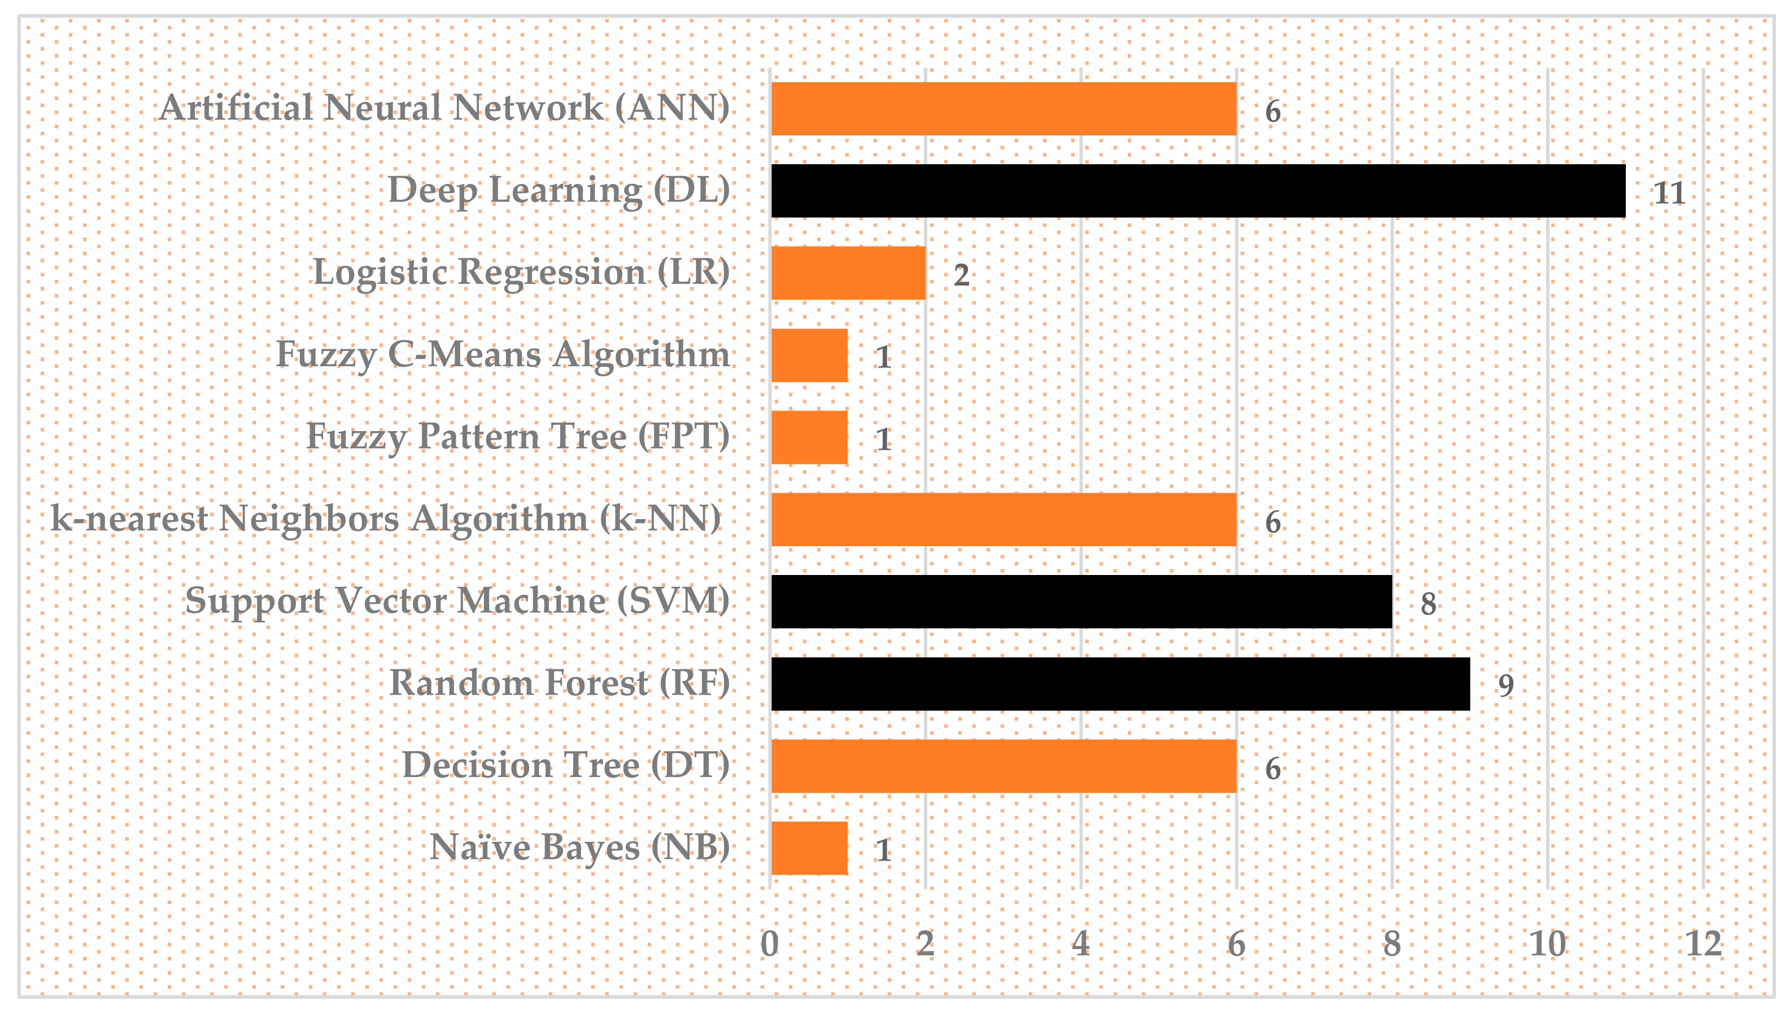
Methods used in recent years

Slide 14
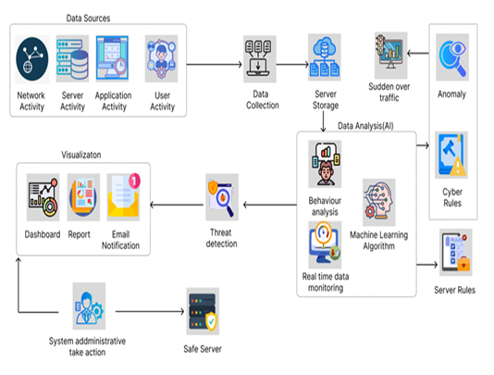
Proposed diagram of the flow of AI driven Cybersecurity system

Slide 15
Discussion
Answer to the R.Q according to our research:
RQ1: How effective is the artificial intelligence system in detecting and preventing server downtime caused by threats?
Answer: The artificial intelligence system demonstrated high efficacy by detecting 95% of threats and issuing timely alerts, thereby reducing server downtime in 98% of cases.
RQ2: How accurate is artificial intelligence in distinguishing between legitimate traffic and threats?
Answer: The system achieved an alert accuracy of 92%, successfully balancing high detection rates with minimal false positives, thus rendering it effective for real-world application.

Slide 16
Conclusion
Study Focus: Examines how AI-driven threat detection can reduce server downtime through real-time threat prediction and mitigation.
SLR Findings: AI is effective in detecting threats, but more research is needed on its role in downtime prevention.
Proposed Solution: A model for real-time threat prediction and automated mitigation to enhance system resilience.
Contribution: Bridges the gap in applying AI to minimize downtime and improve cybersecurity response efficiency.

Slide 17
Limitations & Future Scope
Limitations:
Limited availability of real-world datasets.
Small sample size of interview respondents.
Future Work:
Explore larger datasets across various industries for broader applicability.
Refine AI models to reduce false positives and improve prediction accuracy in diverse environments.

Slide 18

Thanks!
Do you have any questions?

